Slide 1



C.A.P WORK PROGRESS UPDATE
AS ON
FEBRUARY 2023 ​

Slide 2
Introduction
Cyber Ambassadors: 4/ school (with exception of one teacher from few districts where the strength is less )
Mentor Teachers: 2 / school ( with exception of one teacher from few districts where the strength is less )
Total No of districts: 33 districts
Total No of schools: 2381 schools
Total No of Mentor Teachers: 4760 teachers
Total No of Cyber Ambassadors in phase II Cyber congress :9424
Total No of mobile devices used from each school: 2 and 1 extra for emergency (in case if a device fails or teacher is on holiday)
Total No of modules: 4
Start date: 07-02-2023
Last date for teaching: 28-3-2023
Activities schedule: Shall continue till July 2023
Days the sessions run: Tuesday, Wednesday, Thursday and Friday
Timings of the session: last period of the school day -3.00 PM to 4.00 PM

Slide 3
Agenda for MEETING 02-02-2023 ON C.A.P
SI. No | CONTENT
1 | Update on Review of CAP programme
2 | LMS update
3 | Update on deliverables to schools(Audio book)

Slide 4
SI. No | CONTENT
1 | Detailed report about training methodology.
2 | Equipping children with material regarding training E – module for 1&2.
3 | Pre and post assessments, matrix analysis of test results of trained cyber ambassadors, impact analysis of the other students of school and community.
4 | Attendance

Slide 5
WORKFLOW OF CAP PROGRAMME
Theory sessions from February 7th 2023 to 28th March 2023 on every Tuesday, Wednesday Thursday, and Friday from 3:00 PM to 4:00 PM. for all 7 zones. for all 7 zones (i.e. 33 districts of Telangana state.) each zone covering around 4- 5 districts.
Theory sessions are covered under 4 modules (syllabus comprising of PPTs, lesson plans.)
Every session is divided into
        Before Session
        During Session
        After Session

Slide 6
Before During After
* Schedule * PPTs * Post Assessment
* Note * YouTube Links * E-Leaflet
* Zoom Link * Link for Attendance
* List of Students * Motivational videos (Those who didn’t submit)
* WhatsApp Links * Photos of SHE team Officers *Note of activity with Timeline
* She Team officers list * Video Bytes of Police officers
* Attendance JOT forms * Instructions
* Activity.
* Preassessment Link
* YouTube Link

Slide 7
Before Session:
Posting the Zoom link which is attached to a note states the Time, Duration, Date, Day, Districts and schools participating in that particular session.
Lists of students details i.e. Name of students, Mentor teachers, School Name, Place, District Name, Unique ID number
Lists of WhatsApp links
Schedule /Time Table
A Note for invitation to the programme.
Corresponding SHE team officers contact numbers were circulated a day prior to the session to each and every zone.
WhatsApp meeting conducted with all nodal officers of BC, SC, ST, SW govt schools of education department
All the district coordination officers are given phone call remainders about the session and instructions to be given to higher authorities of education department about attendance JOT forms and Pre assessment forms.

Slide 8
During Session:
Session started with Pep up time 15min and instructions to students.
Introduction of master trainer.
Q/A by master trainer / Oath taking.
Content orientation through PPT slides and examples.
Interaction with children with live examples.
Q/A by the students.
After Session:
Instructions about activity.
Post assessment.
E-leaflet
Demo Video on filling JOT forms
Closing of session.

Slide 9
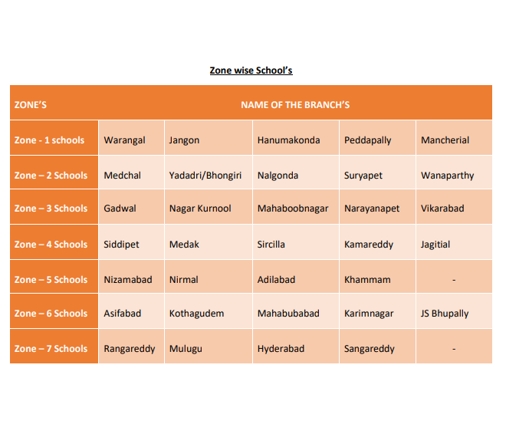

Slide 10
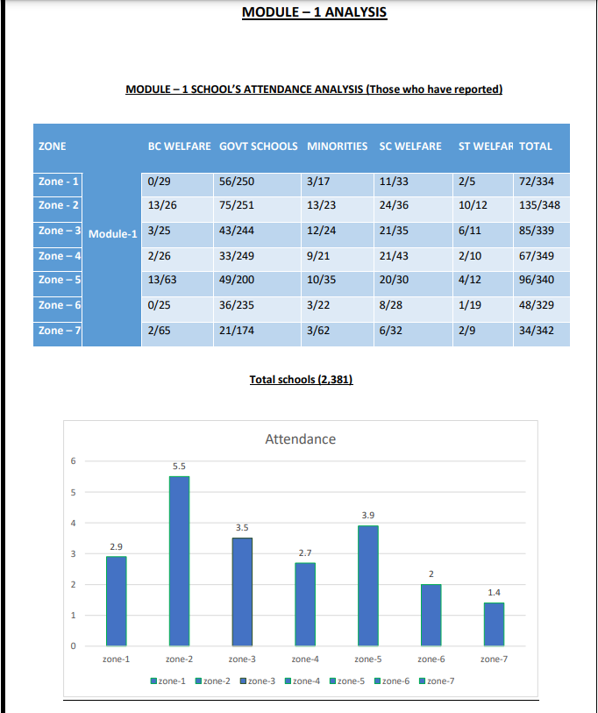

Slide 11
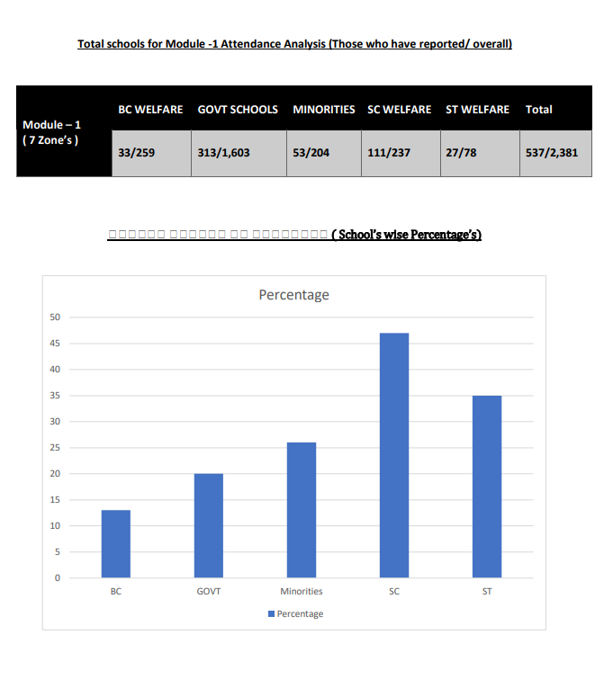

Slide 12
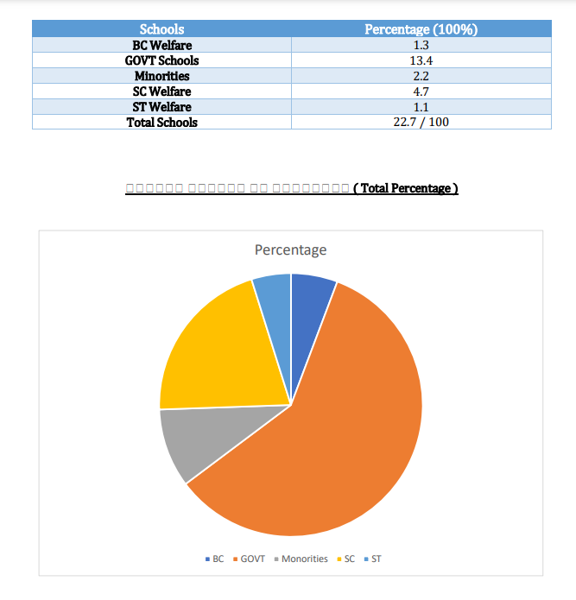

Slide 13
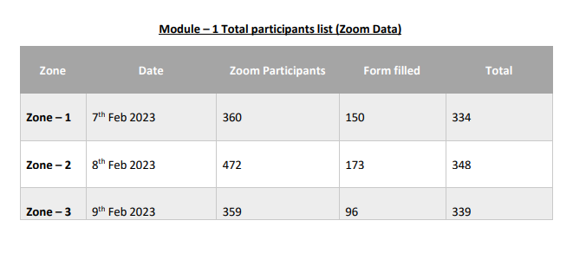
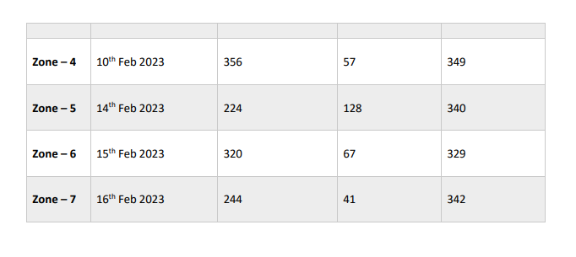

Slide 14
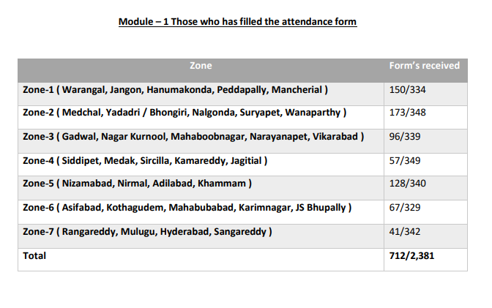
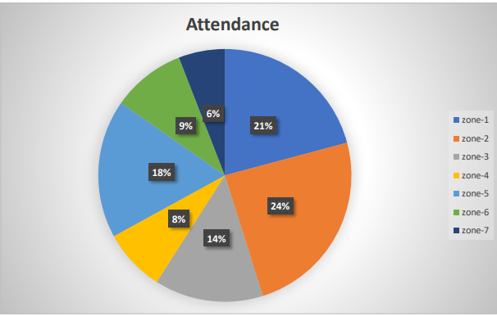

Slide 15
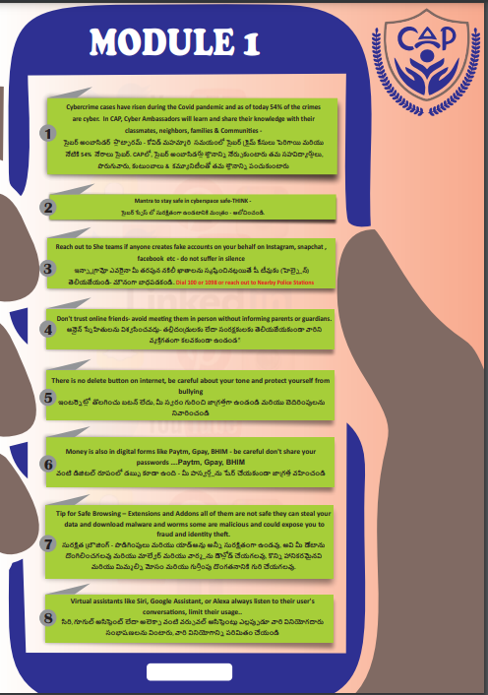

Slide 16
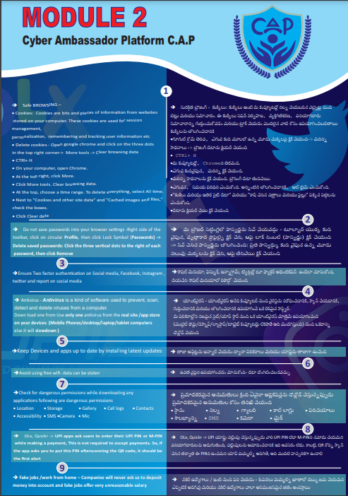

Slide 17



Slide 18
